Slide 1
Recognition of Drum Music using Sound and Video
Kwansei Gakuin Univercity
Kodai Hara Hiroyoshi Miwa

Slide 2
Introduction(1/2)
Problem
For beginners, it is difficult to learn drumming from the videos uploaded on video sites because the performance video is too fast or some movement is not visible behind other instrument or object, and it is costly to buy a drum score
Solution
Make an automatic drum music scoring system using sound and video
Notes:
And what it means to make an automatic drum music scoring system using sound and video is to

Slide 3
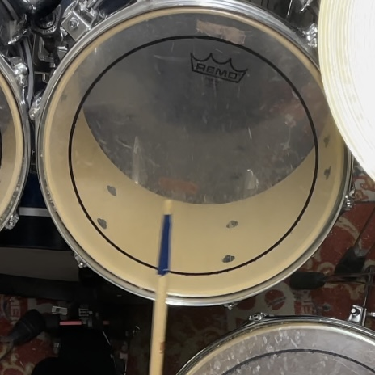
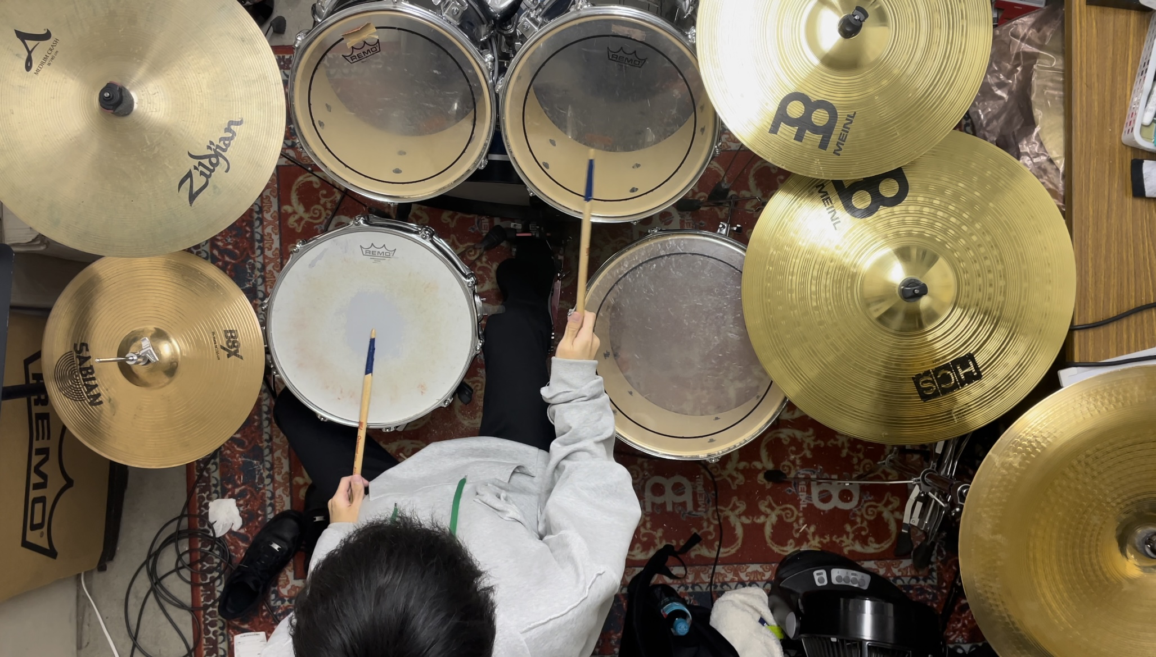
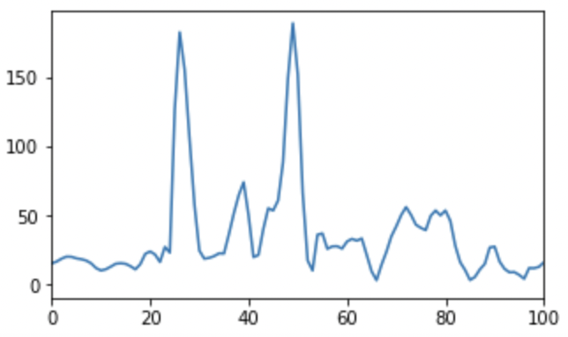
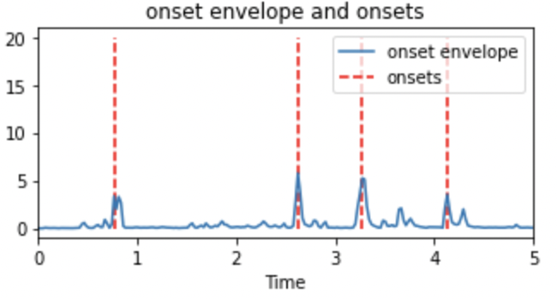
Introduction(2/2)
Notes:
First from the drum performance video
we detect the onset timing of the instruments
then, we detect which percussion instrument is sounded by analyzing both video and sound.
and if the same instrument was detected as sounded on both video and sound, we plot that instrument as sounded on the drum score

Slide 4
Related works(1/2)
Methods based on NMF
Performs well with only small amount of learning data
▼Needs improvement in music containing multiple percussion sounds or mixed with musical instrument tones containing melodies
Methods based on RNN
Is most promising and boast high accuracy in acoustic signal analysis
▼Needs large data set
Notes:
there were multiple related works of drum recognition but
methods based on non-negative matrix factorization and
methods based on recurrent neural network are the representative.

Slide 5
Related works(2/2)
Most of the previous studies have used electronic drum sound sources or limited the music of the drum set containing only three percussion instruments; the hi-hat snare drum and bass drum
▷It is difficult to identify drum sound only by sound because it changes sound by how or who plays
We propose a method to increase the accuracy of the automatic drum music scoring including 9 instruments by using both sound and video of a drum performance

Slide 6
Overview of proposed method
Input WAV file(22050Hz 16bit mono)
We used video analysis to overcome the disadvantages of methods that analyze with only acoustic signals has, such as the difficulty of classifying percussion instruments which has similar frequency peaks
Input MP4file(30fps 3840*2160)
STFT
Binarize every frame
Detect onset time
Put median filter
Classify the type of each instruments based on its frequency response
Detect overlap between area of instruments and marker
Output the combined result of each
Notes:
now I am going to explain the overview of our proposed method.
Short time Fourier transform to analyze frequency by time

Slide 7
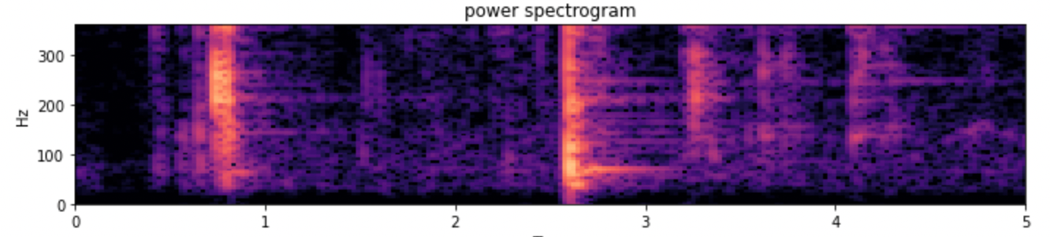
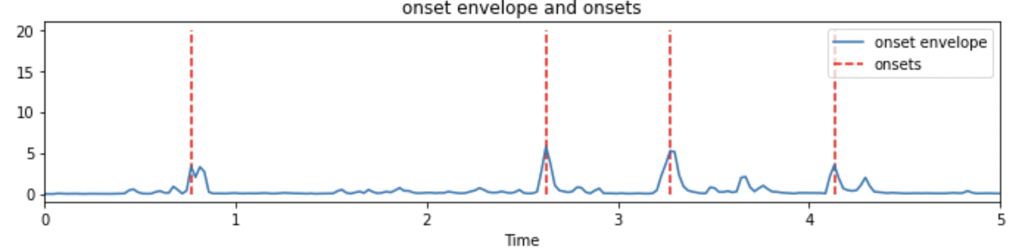
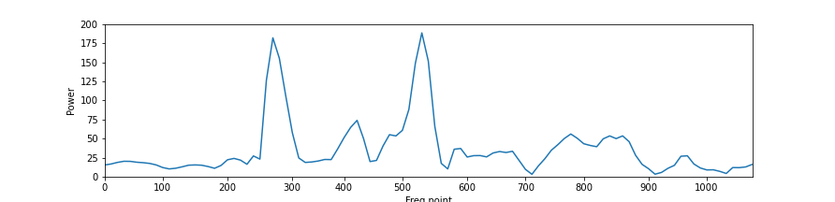
Acoustic signal processing(1/2)
STFT the acoustic signal then make a power spectrogram
Detect the onset timing from the peak of onset strength
Classify which instrument is sounded by checking the frequency peak on the onset timing
Notes:
From now on i am going to explain our proposed method with more details.

Slide 8
Acoustic signal processing(2/2)
The instrument that has sounded on the onset timing are selected by checking if it has a frequency peak of any instrument which we have previously investigated
Frequency peak of each instruments
Instrument | Frequency peak(Hz)
Bass drum | 75
Snare drum | 194
High tom | 269
Low tom | 258
Floor tom | 86
Hi-hat | 355
Crash cymbal L | 516
Crash cymbal R | 613
Ride cymbal | 839
Notes:
For example, when the power spectrum looks like this on the onset timing, we can see that there is a frequency peak in about 270.
then we check the frequency peak of each instruments which we have previously investigated.
then we assume that the high tom has sounded on the onset timing because the high tom has a frequency peak in 269.

Slide 9
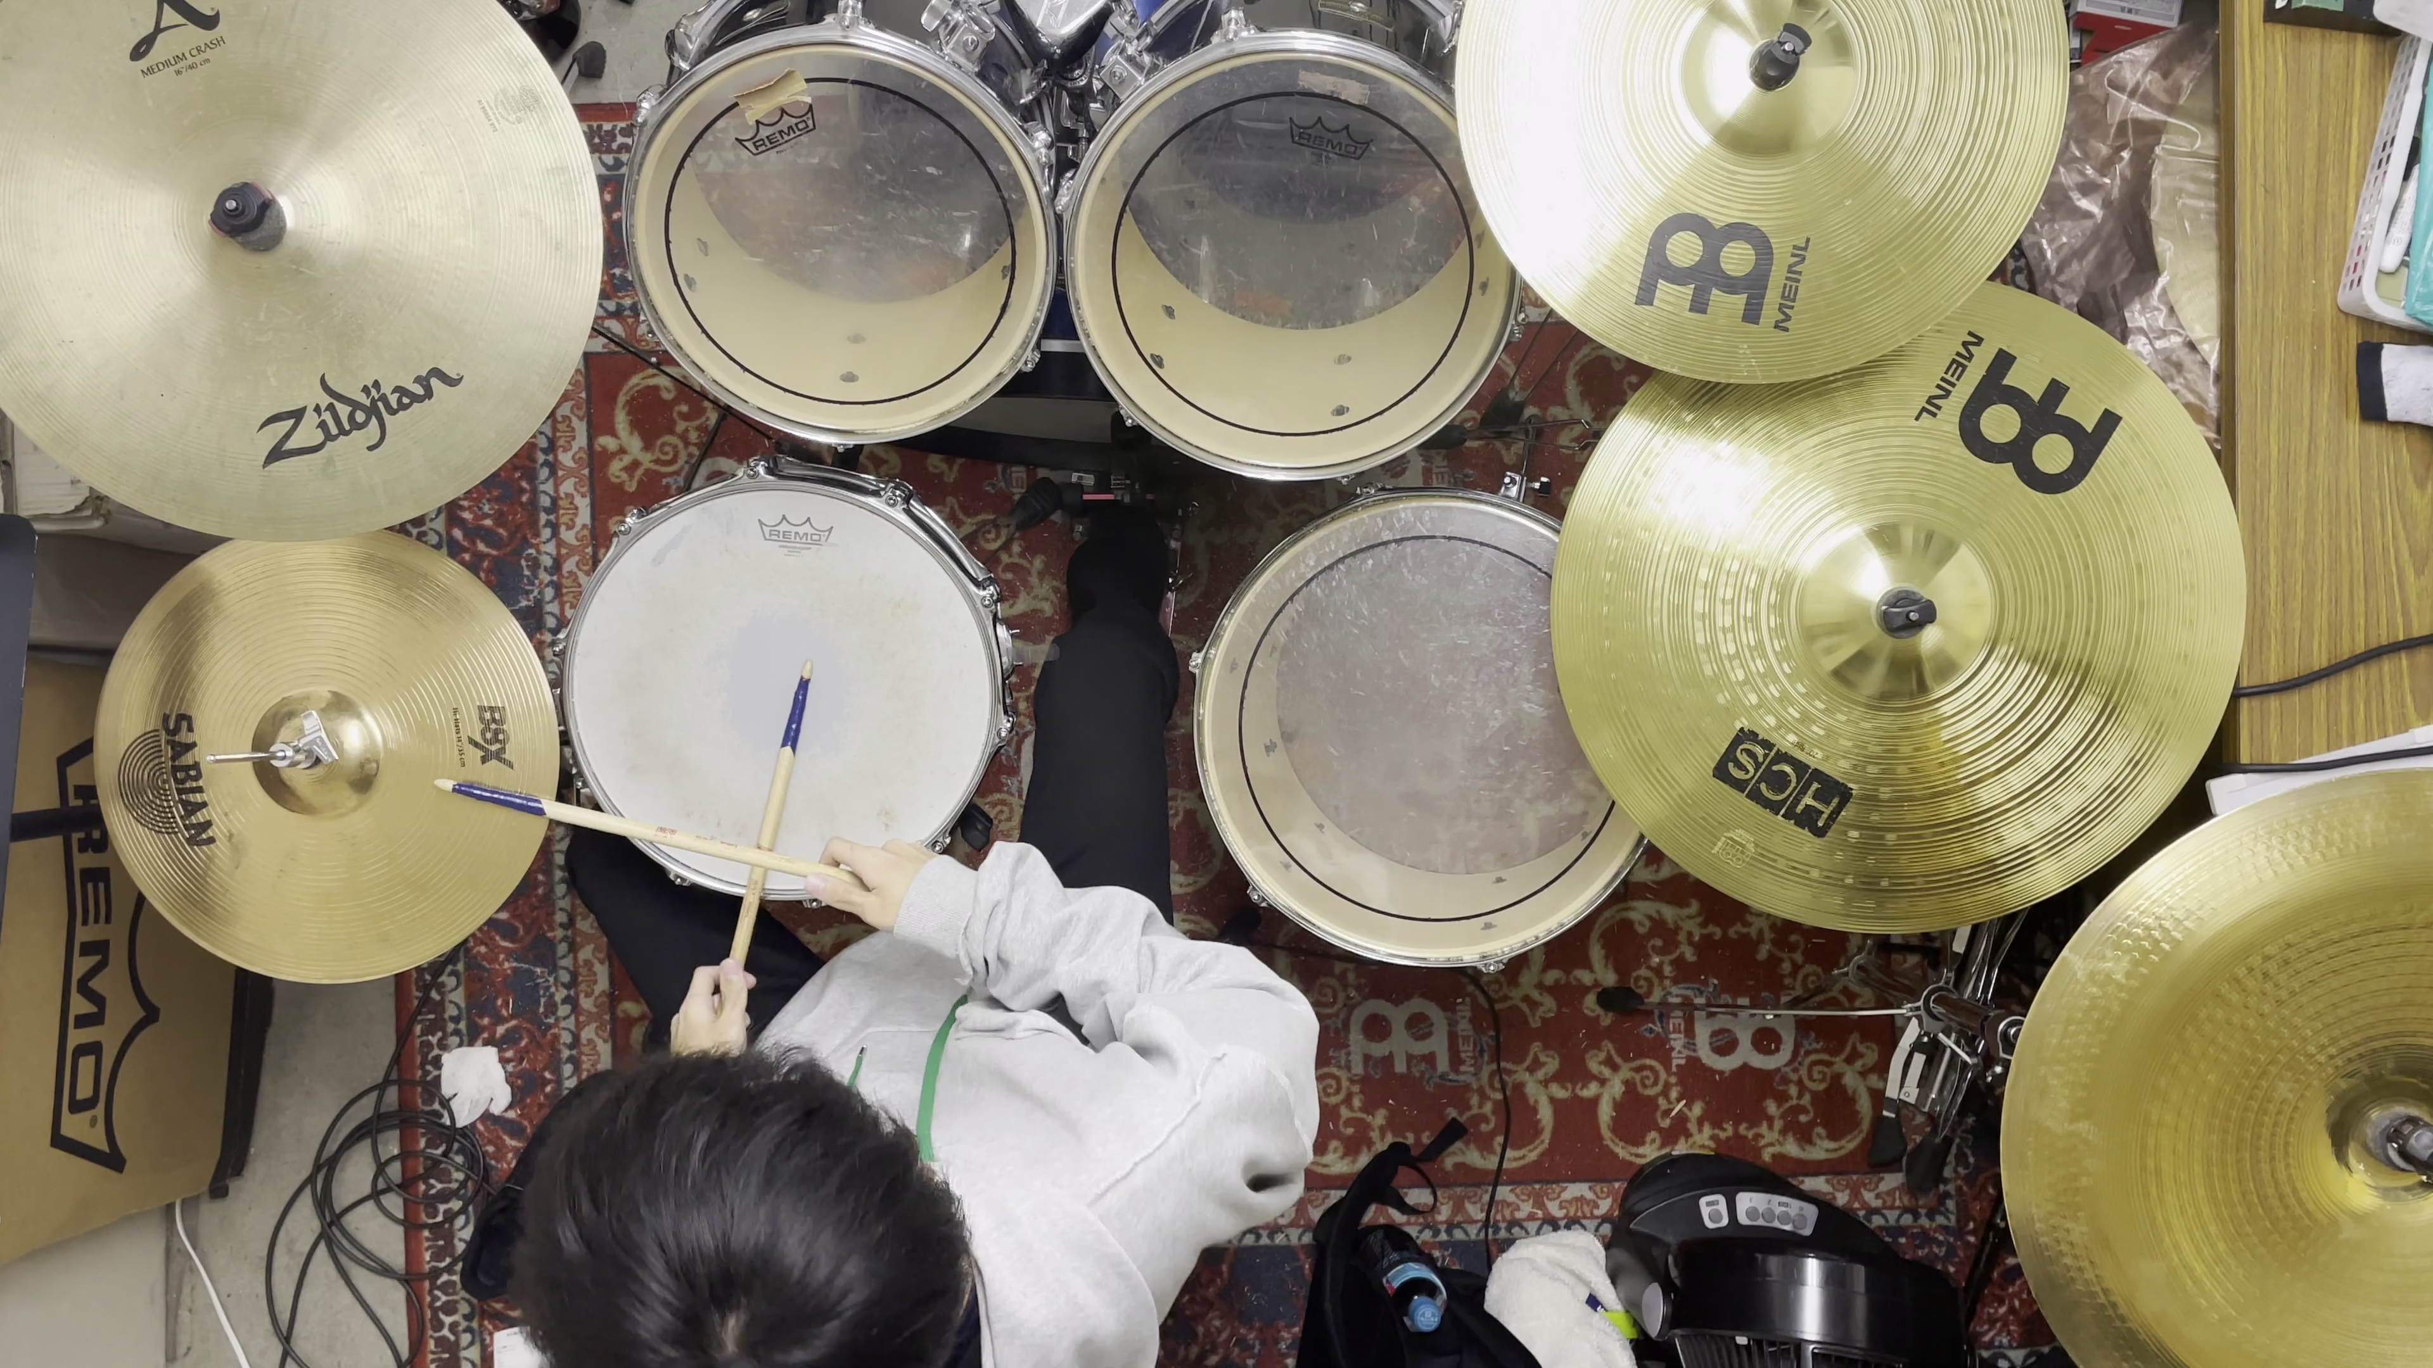
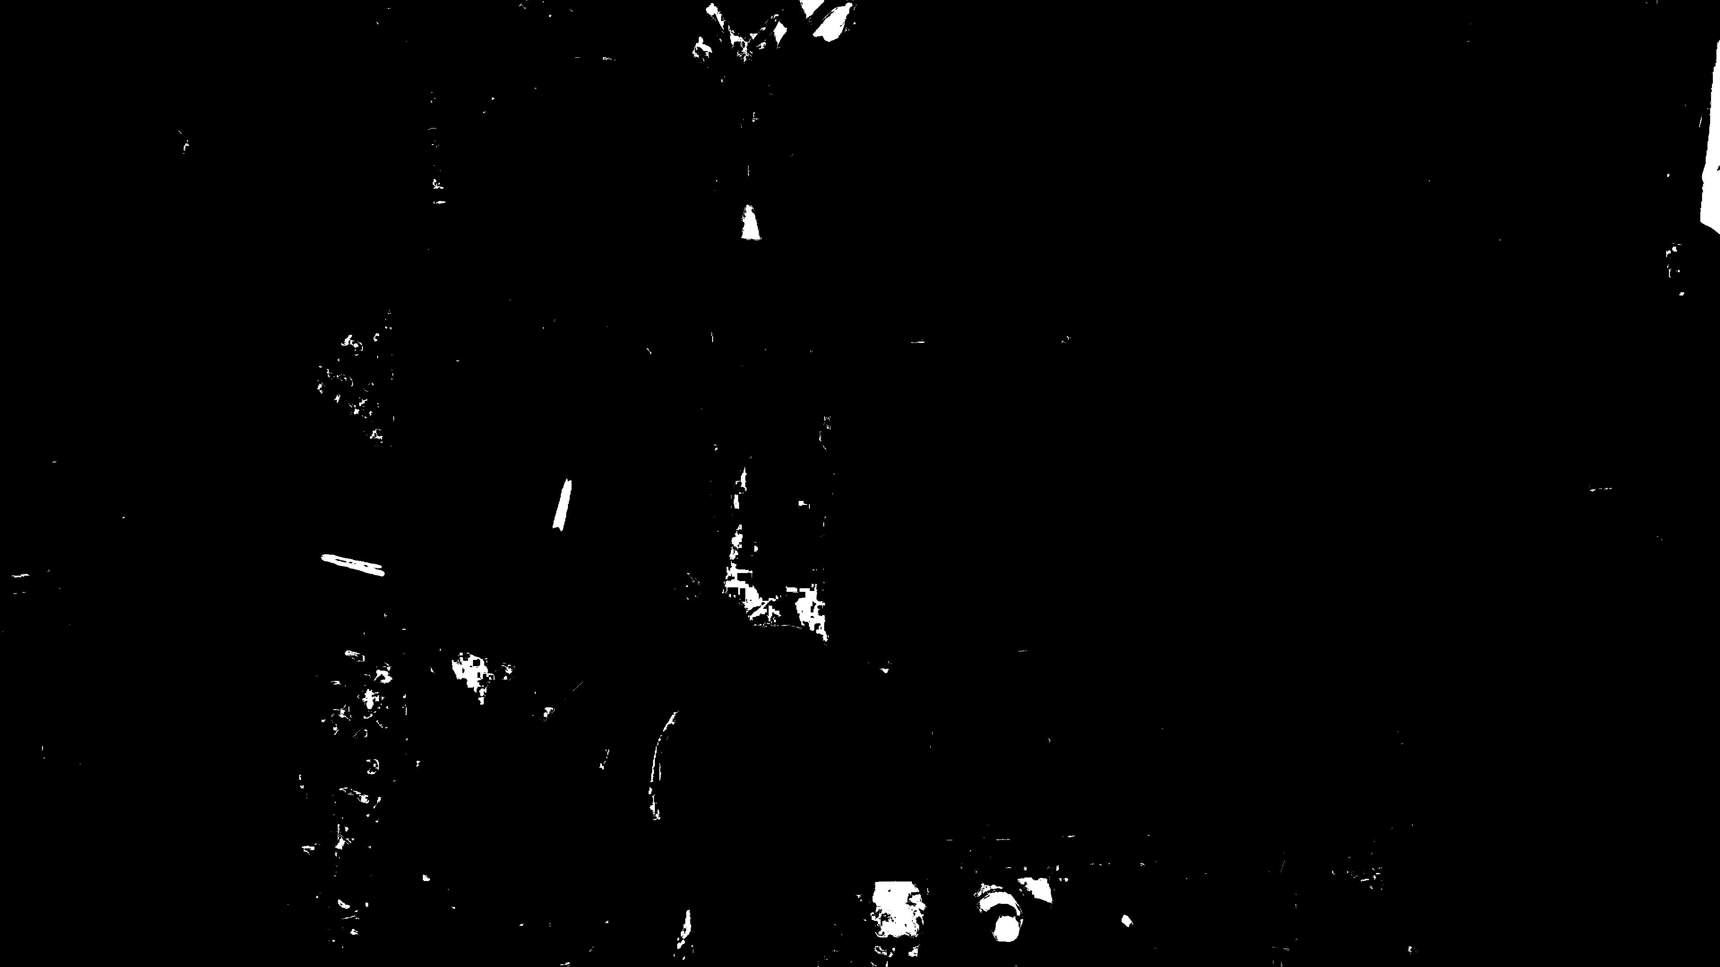
Video analysis(1/5)
Binarize each frame of the video by the color of the marker on the drum stick and others
Image while playing the drum
After binarization
Notes:
You can see that there are some noises on the image after binarization.

Slide 10
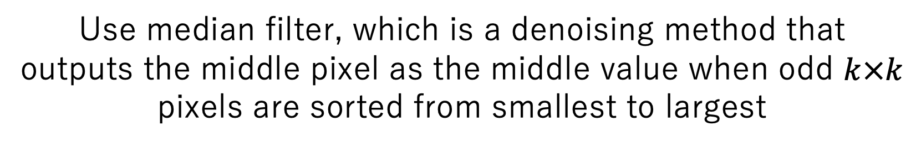
Video analysis(2/5)
Use median filter, which is a denoising method that outputs the middle pixel as the middle value when odd $k×k$ pixels are sorted from smallest to largest
1
1
0
For example, if k=3, 3×3 pixels are chosen centered on every pixel
Then, all 9 pixels are sorted from smallest to largest
Lastly, the middle pixel of the 3×3 square will change to the middle pixel when sorted
0
1
1
0
0
0
0
0
0
0
0
0
1
1
1
1

Slide 11
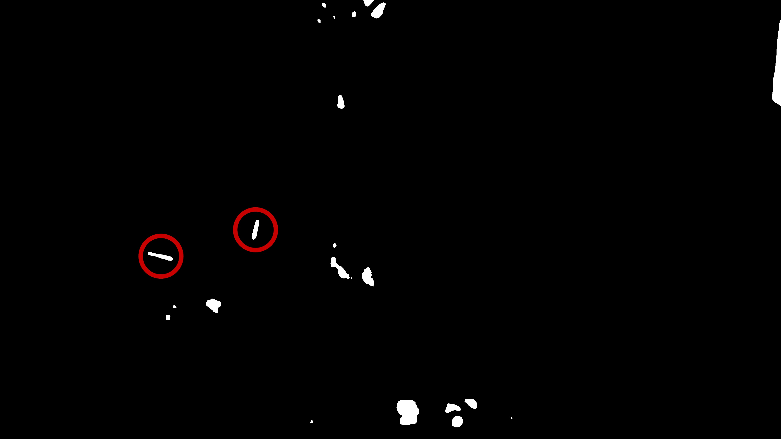
Video analysis(3/5)
Before median filter
After median filter
Notes:
you can see that the image is denoised after using median filter, and also clearly see the marker on the drum stick which is shown in the red circle.

Slide 12
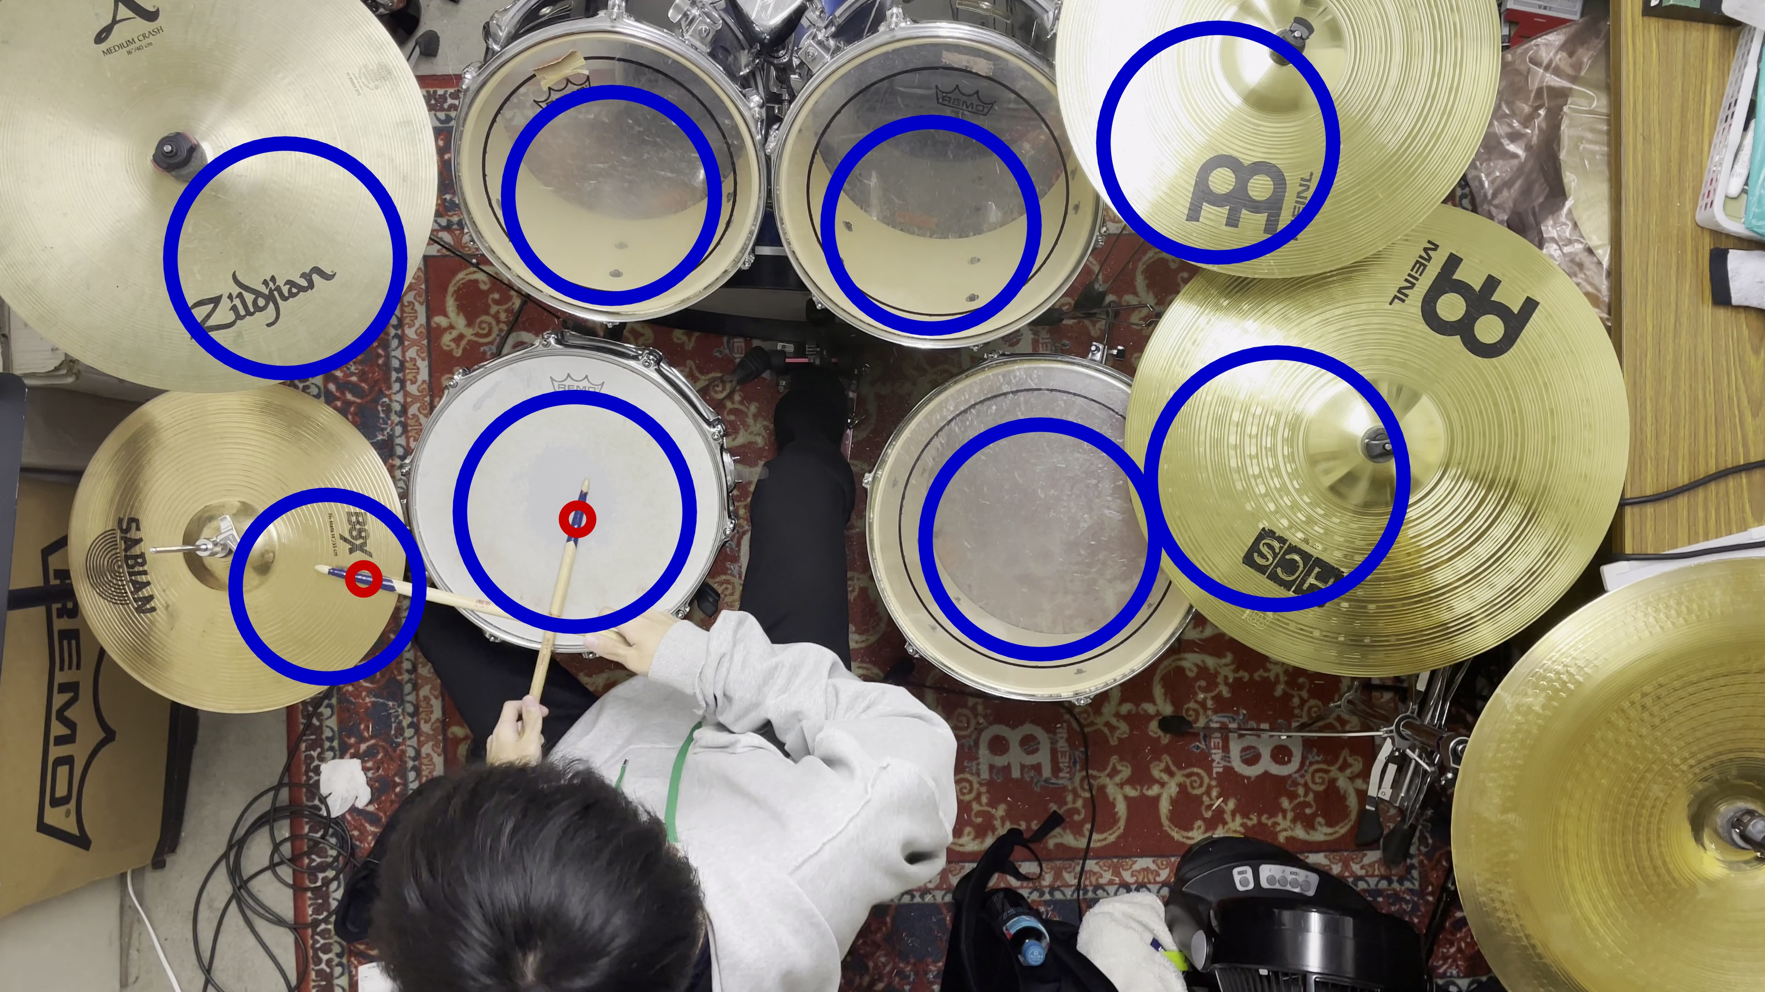
Video analysis(4/5)
Classify the instruments by checking the overlap of
marker and the area of the instruments
Red circle: Marker on the stick
Blue circle: Area of the instruments
If anything which has a color of the marker overlaps the area of the instrument, it is detected as the instrument was sounded.

Slide 13
Video analysis(5/5)
Notes:
this is the final video after all the video analysis.
when the marker on the drum stick overlaps the area of the percussion instrument which is the blue circle, it is detected and shown with the red circle.

Slide 14
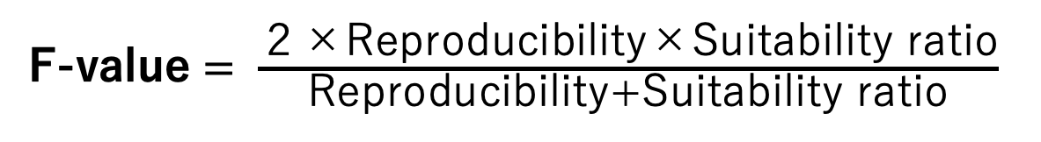
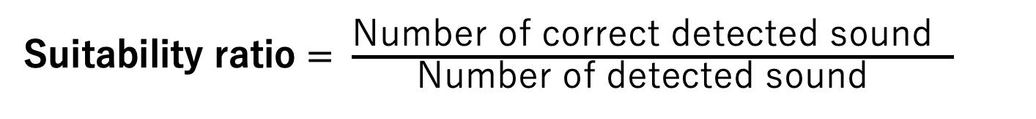
Performance evaluation(1/4)
Perform an original piece of music which includes 9 percussion instruments at 5 different BPM and evaluate using reproducibility, suitability ratio, and F-value
Harmonic mean of Reproducibility and Suitability ratio
The value ranges between 0 to 1 and the closer it goes to 1, both reproducibility and Suitability ratio are high.
Reproducibility $= \frac{\text{Number} \text{of} \text{correct} \text{detected} \text{sound} }{\text{Number} \text{of} \text{times} \text{the} \text{instrument} \text{actua}\text{l}\text{ly} \text{sounded} }$
Suitability ratio $= \frac{\text{Number} \text{of} \text{correct} \text{detected} \text{sound} }{\text{Number} \text{of} \text{detected} \text{sound} }$
F-value $= \frac{\text{２}\text{×}\text{Reproducibility}\text{×}\text{Suitability} \text{ratio}}{\text{Reproducibility}\text{+}\text{Suitability} \text{ratio}}$
Notes:
calculated
divided by

Slide 15
Performance evaluation(2/4)
In all cases, the F-value of our proposed method is higher
Comparison of F-value of music recognition between proposed method and with only acoustic signal
Instrument | BPM | F-value of proposed method | F-value of Acoustic signal | Difference
Low tom | 80 | 1 | 0.24 | 0.76
 | 100 | 0.83 | 0.29 | 0.54
 | 120 | 0.83 | 0.29 | 0.54
 | 140 | 0.86 | 0.41 | 0.45
 | 160 | 0.4 | 0.19 | 0.21
Difference
0
0
0
0
0
0
0.01
0.02
0.01
0.02
0.46
0.47
0.36
0.17
0.17
Difference
0.76
0.54
0.54
0.45
0.21
0.27
0.3
0.33
0.25
0.31
0.55
0.55
0.54
0.48
0.49
Difference
0.89
0.58
0.82
0.65
0.23
0.8
0.77
0.55
0.62
0.61
0.57
0.57
0.55
0.51
0.5
Instrument | BPM | F-value of proposed method | F-value of Acoustic signal | Difference | Instrument | BPM | F-value of proposed method | F-value of Acoustic signal | Difference | Instrument | BPM | F-value of proposed method | F-value of Acoustic signal | Difference
Bass drum | 80 | 0.8 | 0.8 | 0 | Low tom | 80 | 1 | 0.24 | 0.76 | Crash L | 80 | 1 | 0.11 | 0.89
 | 100 | 0.79 | 0.79 | 0 |  | 100 | 0.83 | 0.29 | 0.54 |  | 100 | 0.67 | 0.09 | 0.58
 | 120 | 0.83 | 0.83 | 0 |  | 120 | 0.83 | 0.29 | 0.54 |  | 120 | 1 | 0.18 | 0.82
 | 140 | 0.83 | 0.83 | 0 |  | 140 | 0.86 | 0.41 | 0.45 |  | 140 | 0.8 | 0.15 | 0.65
 | 160 | 0.83 | 0.83 | 0 |  | 160 | 0.4 | 0.19 | 0.21 |  | 160 | 0.33 | 0.1 | 0.23
Snare drum | 80 | 1 | 1 | 0 | Floor tom | 80 | 0.82 | 0.55 | 0.27 | Crash R | 80 | 1 | 0.2 | 0.8
 | 100 | 1 | 0.99 | 0.01 |  | 100 | 0.85 | 0.55 | 0.3 |  | 100 | 1 | 0.23 | 0.77
 | 120 | 0.99 | 0.97 | 0.02 |  | 120 | 0.88 | 0.55 | 0.33 |  | 120 | 0.77 | 0.22 | 0.55
 | 140 | 0.93 | 0.92 | 0.01 |  | 140 | 0.83 | 0.58 | 0.25 |  | 140 | 0.86 | 0.24 | 0.62
 | 160 | 0.95 | 0.93 | 0.02 |  | 160 | 0.89 | 0.58 | 0.31 |  | 160 | 0.86 | 0.25 | 0.61
High tom | 80 | 0.82 | 0.36 | 0.46 | Hi-hat | 80 | 0.99 | 0.44 | 0.55 | Ride cymbal | 80 | 1 | 0.43 | 0.57
 | 100 | 0.88 | 0.41 | 0.47 |  | 100 | 0.99 | 0.44 | 0.55 |  | 100 | 0.99 | 0.42 | 0.57
 | 120 | 0.69 | 0.33 | 0.36 |  | 120 | 1 | 0.46 | 0.54 |  | 120 | 0.98 | 0.43 | 0.55
 | 140 | 0.3 | 0.13 | 0.17 |  | 140 | 0.97 | 0.49 | 0.48 |  | 140 | 0.95 | 0.44 | 0.51
 | 160 | 0.3 | 0.13 | 0.17 |  | 160 | 0.96 | 0.47 | 0.49 |  | 160 | 0.96 | 0.46 | 0.5
We can see that in all BPM of the music, the F-value of the proposed method is higher because the value is all positive on the difference section
In all instruments, we analyzed the proposed method, and the method using only acoustic signal by the F-value, in 5 different BPM
Notes:
lets see closer to the table of the instrument low tom
from the left, table shows,
also when you see the section difference in all cases,

Slide 16
Performance evaluation(3/4)
Instruments that has lower F-value than others due to
the similarity of the frequency peak, in the proposed method
Instrument | Frequency peak | BPM | F-value
Bass drum | 75 | 80 | 0.8
 |  | 100 | 0.79
 |  | 120 | 0.83
 |  | 140 | 0.83
 |  | 160 | 0.83
Floor tom | 86 | 80 | 0.82
 |  | 100 | 0.85
 |  | 120 | 0.88
 |  | 140 | 0.83
 |  | 160 | 0.89
Frequency peak
75
86
Frequency peak
75
86
Instrument | Frequency peak | BPM | F-value
High tom | 269 | 80 | 0.82
 |  | 100 | 0.88
 |  | 120 | 0.69
 |  | 140 | 0.3
 |  | 160 | 0.3
Low tom | 258 | 80 | 1
 |  | 100 | 0.83
 |  | 120 | 0.83
 |  | 140 | 0.86
 |  | 160 | 0.4
Frequency peak
269
258

Slide 17
Performance evaluation(4/4)
F-value is lower when BPM is higher
due to the difficulty of onset detection
Instrument | BPM | F-value
High tom | 80 | 0.82
 | 100 | 0.88
 | 120 | 0.69
 | 140 | 0.3
 | 160 | 0.3

Slide 18
Conclusion
Research
We propose a method to increase the accuracy of the musical scoring by using both sound and video of drum performance
Results
F-value of the music recognition by the proposed method exceeded the
F-value of the method using only acoustic signal
Method using both sound and video is effective in music recognition of drums

Slide 19
Spare slides from now on

Slide 20
Conclusion
Difficulties
Difficult to classify high tom and low tom, floor tom and bass drum due to the similarity of frequency peak
High tom, low tom, crash cymbals were sometimes not recognized because frequency peak changes depending on the way of hitting
Onset were not detected in quick performances

Slide 21
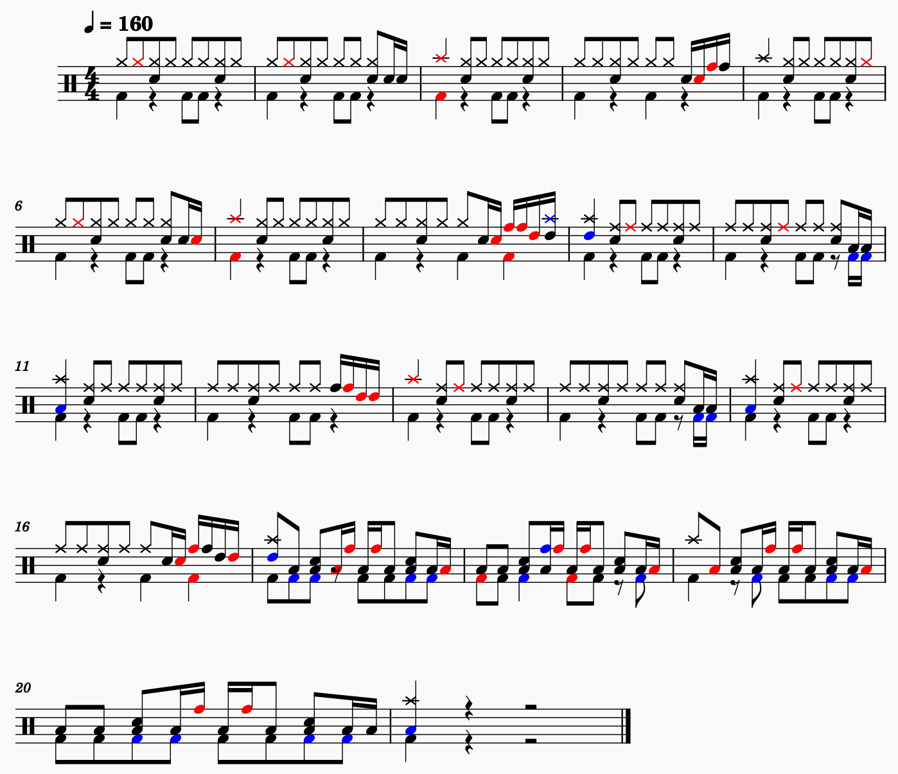
Performance evaluation
Drum score of the results at BPM160
♪
Notes that are played but not recognized
♪
Notes that are not played but recognized as played
♪
Notes that are played and are recognized
Onset detections are not working well at 16-part notes

Slide 22
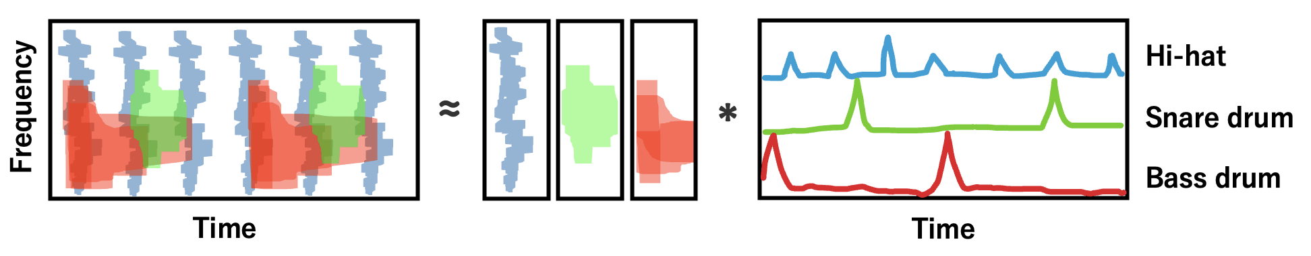
Non-negative Matrix Factorization
NMF is an algorithm that decomposes a nonnegative matrix into two other nonnegative matrix
When it is applied to the voice of a drum, it can be decomposed into the average spectrum and activation of each percussion instruments

Slide 23
Music Recognition using RNN
The input is 64 frequency nodes. Value is the volume.
The output is the activation of each instruments. Value is the probability.
128Hz
Hi-hat
NN
IN
OUT
126Hz
Snare drum
64 nodes
2Hz
Bass drum

Slide 24
Short-Time Fourier Transform
A fundamental concept in signal processing that allows to analyze the frequency component of signal over time. By applying a Fourier Transform to small segments of a signal at different time intervals, the STFT provides a way to examine how the frequency components change over time.
Audio File
Multiply
Window function
FFT
FFT
FFT

